Slide 1
ME-461, Manufacturing Technology, Lecture 1
Date: 04/01/2018
Instructor Incharge : Shantanu Bhattacharya

Slide 2
Manufacturing Systems Approach
Definition of Manufacturing Technology:
Manufacturing technology provides the tools that enable production of all manufactured goods. These master tools of industry magnify the effort of individual workers and give an industrial nation the power to turn raw materials into the affordable, quality goods essential to today’s society.
Manufacturing technology provides the productive tools that power a growing, stable economy and a rising standard of living. Thus manufacturing process really represents adding value to a raw material and creation of wealth.
Replenish
Sales fluctuations
Production rate, quality and delivery
Raw materials cost and availability
Manufacturing System comprising of manufacturing processes
Manufacturing Facility Add Value
Business environment
Profit
Output
Input
Social Pressure
Reputation
Resources and plans
Wealth
Manufacturing Process is the key to wealth generation

Slide 3
Manufacturing Enterprise
For a manufacturing enterprise of the twenty first century business environment the customer is the king.
The business environment is characterized mainly by products of increasing variety and lower demand.
This has led to the empowerment of Customer individualism as a central theme of all businesses.
This necessitates the manufacturing of highly customized products sometimes customized to the needs and necessities of individual customers.
Historically the 1970’s were dominated by the cost of product as a main lever to obtain competitive supremacy.
Later 1980’s were dominated by the low cost, high performance, high quality product.
Currently, the customer takes high quality and low cost to be granted and is more focused to other factors like:
Finding out his exact product expectation and requirement (customization)
Reduced delivery lead times.
Environmental issues like reduced waste generation etc.

Slide 4
Manufacturing Enterprise
So the current focus of any manufacturing enterprise is to develop a mechanism to understand the customer needs and develop internal mechanisms to respond to the changing needs quickly and inexpensively.
So most of the factories follow the reverse direction thinking that build products from customer needs and expectations.
In other words we can say that a future successful manufacturing organization will be a virtual corporation that is instantaneously responsive to customer needs. (Industry consortium on twenty first century manufacturing , Goldman and Priess)

Slide 5
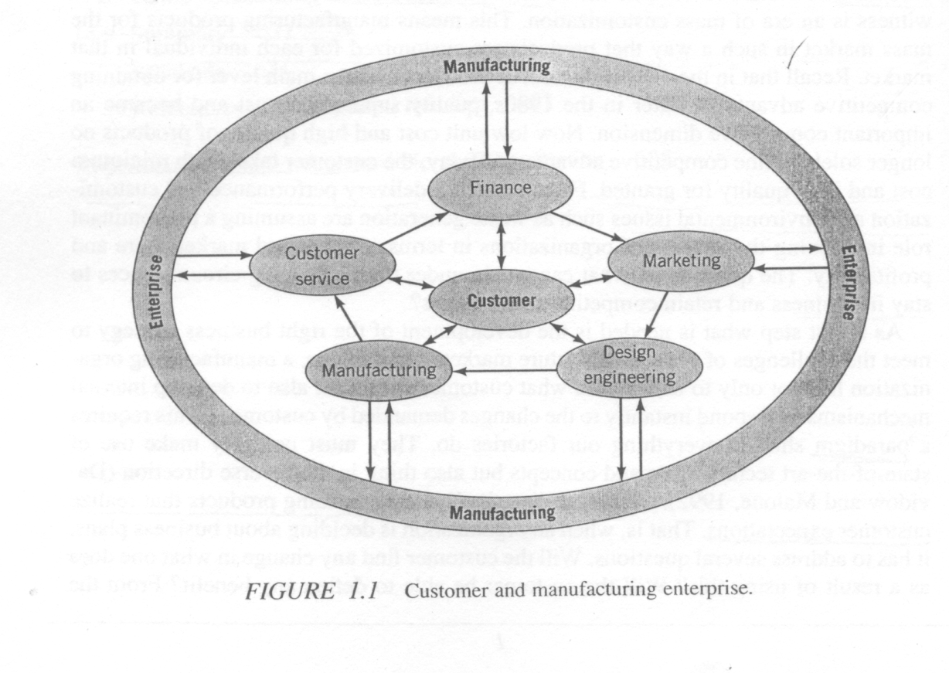
Manufacturing Enterprise
We know how the various functional organs of any manufacturing enterprise such as finance, sales and marketing, design and manufacturing and human resources receives feedback about product, product attributes and market segments.
That is also one of the reasons why customer plays a pivotal role.
Corporate objectives such as growth in market share, profitability, workforce stability, and other financial measures associated with any manufacturing enterprise emanate from the study of the market place.

Slide 6
What can marketing identify which would help the manufacturing enterprise?
Range of products, product market segment, product ideas to satisfy customer needs.
Can a company deliver the kinds of products needed to satisfy the order winning criteria such as cost, quality, lead time and so on?
The answer to this question would lie in product design and manufacturing which explores the various design and process options as well as assesses the infrastructure to see if they can satisfy the order winning criteria.
Obviously , the human resources, technology, finance, and business processes in the company play a major role in answering this question and their interaction with manufacturing is very important.
So, a manufacturing strategy is really a collaborative decision making that should satisfies everybody’s needs an necessities and is also a way to achieve congruence between corporate strategy, marketing goals and manufacturing capabilities of an enterprise.

Slide 7
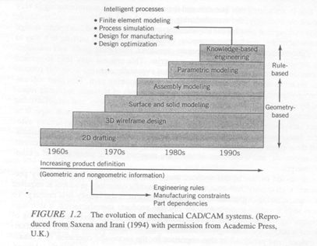
A historical perspective of Design
Design and manufacturing are core activities for realizing a marketable and profit making product.
The figure below shows the evolution of mechanical CAD/CAM systems over the past three decades. CAD technology emerged to facilitate representation completeness.
3. First there was the development of 2-D drafting in 1960s which extended to 3D models principaly initiated by the wireframe based modeling systems. However, it was not possible to represent higher order geometry data such as surfaces.
4. In 1970 surface based models were developed which evolved surface data for boundary representations although this was not sufficient to represent solid or volume enclosure information.
5. All solid modeling schemes have an inherent weakness in that they provide a low level representation of parts in terms of only providing geometric and topological data constituting the model
6. This led to a slightly higher order modeling of parametric and variational design which finally emerged as knowledge based engineering system that captures a lot of additional non geometric product information like engineering rules, part dependences, manufacturing constraints etc.
Notes:
The need for solid modeling was necessitated by NC verification codes and automatic mesh generation activities. A large no. of software like Pro/Engineer (parametric technology), IDEAS from (Software research and development corporation), Unigraphics (electronic datasystems) and MES from intergraph corporation cam into business.
The powerful tool ICAD developed at Cambridge, Masachussets is one of the tools used for object oriented modeling technology.

Slide 8
Modern manufacturing
Definitionaly modern manufacturing is a series of interrelated activities and operations involving design, material selection, planning, production, quality assurance, management, and marketing of discreet consumer and durable goods.
Manufacturing can be classified into continuous and discreet product production processes and we will be principally focusing on the discreet production technology.
The modern manufacturing being very sensitive to the customer want and need and the market environment is a combination of attributes of mass production and job shop production.
Such systems having attributes from both are known as flexible manufacturing systems.
They rely heavily on CNC equipment, AGVS, ROBOTS and group technology approaches which rely heavily on similarities in part production by virtue of their design attributes and manufacturing features.

Slide 9
A historical perspective of modern manufacturing
The concept of a factory and productivity improvement is really attributed to the father of modern day economics , a Scotish national Adam Smith whose famous work on the division of labor entitled “An Inquiry into the Nature and Causes of the Wealth of Nations.” was one of the first treatises in 1776 on modern day economics and capitalism.
Development of the flow assembly line system for engine manufacturing by Henry Ford in 1913 was a giant leap towards the modern day manufacturing.
Some other philosophers like Frant Gilbreth who developed the concept of motion study and elimination of wasteful motions and Henry Gantt who devloped a systematic graphing procedure for preplanning, scheduling of activities and progress review and schedule updating.
In the area of machines G.C. Devol developed a controller device in 1946 that could record electrical signals magnetically and play them back to operate a mechanical machine. A no. of interesting developments have taken place since then in the area of machine tools.

Slide 10
Numerically Controlled Machines: A historical Perspective
The first successful numerical machine tool was developed at MIT under a subcontract from Parsons Corporation, Michigan on Air force funding in 1950.
Automatic tool changers and indexing worktables were added in 1960s.
During this period the concept of DNC (direct numeric control) in which several NC machines are linked to a main computer was developed.
Control system development in 1971 was the next milestone which lead to the development of microcontroller controlled NC machines also called CNC machines.
The major advantage of a CNC machine was in its ability to store part programs and also interact with other controllers or central computer which led to the development of distributed NC systems wherein several CNC machines would be connected to a central host computer.
The power of the NC machines were further enhanced in 1980 by making them capable of carrying hundreds of tools, having multiple spindles and controlling movements upto 6 axis.

Slide 11
Material Handling Systems
Material handling is an integral part of any manufacturing system.
Manufacturing system performance can be significantly improved by using computer controlled material flow , which reduces waiting time and work in process inventory compared with manual loading and unloading and manual material handling systems.
To this end the development in floor mounted and over head roller conveyors, stacker cranes and automated guided vehicles have contributed substantially to smooth material flow in factory floors.
Through a system of PLCs, computer network, material handling systems, material storage systems and machine tools can be integrated to configure an automated manufacturing system.

Slide 12
ROBOTICS
The word was satirically used for the first time in the play “Rossum’s Universal Robots” written by Karel Capek in 1921 and indicated forced labor.
Since then robotics has really witnessed a series of technological changes.
The technology for the current generation of industrial robots was developed simulataneously by C.W. Kenward in Great Britain in 1954 and G.C. Devol in United States.
The first computer type robot programming language was developed a Stanford Research Institute in 1973 wherein the language AL was developed.
Nowadays robots are used for a variety of applications like painting, welding, material handling and assembly.

Slide 13
Objectives of this course
The main goal of the above collaborative decision is to formulate a design and manufacturing plan which is prinicipally built considering aspects like product and process definition and capability, manufacturing planning and control, and factory automation strategies.
In doing so it is very important to have a thorough understanding of the concepts of design and manufacturing technology and management and also other functional areas like finance, marketing and sales, personal etc.
The focus of this course would be limited to the design and manufacturing technologies enabling the functioning of a successful manufacturing enterprise.
Accordingly we would discuss some concepts of Computer aided design, Computer aided process planning, Computer aided manufacturing, quality engineering, automated material handling, manufacturing planning and control, Lean manufacturing and Flexible manufacturing.

Slide 14
Topics to be covered
(Computer Aided Design, CAD)
The Product Design Process
Problem identification, Preliminary ideas, refinement process, analysis process, decision process, Implementation process
Computer Aided Design
A brief history of CAD
CAD/CAM system
Mainframe based systems, Minicomputer based systems, Workstation based systems, Microcomputer based systems
CAD system Input-Output Devices
Selection of CAD/ CAM systems
Computer graphics and transformations
Geometric transformation, homogeneous representation, Composition of transformations

Slide 15
Topics to be covered
(Geometric Modeling)
Introduction to geometric modeling.
Why is knowledge of geometric Modeling Necessary?
Geometric Modeling Approaches
Wireframe Modeling
Limitations of wireframe modeling, Wireframe Entities, Analytic curves, Representation of curves, Nonparametric representation of curves, Parametric representation of curves, Synthetic curves, Parametric representation of Synthetic curves, Hermite cubic spline, Bezier curves, B-Spline, Rotational B-Spline and non uniform rotational B-Spline curves, Curve manipulations.
Surface modeling
Surface entities, surface representations

Slide 16
Topics to be covered
(Computer Aided Process Planning)
Overview of manufacturing processes
Turning Operations, Drilling Operations, Milling Operations, Grinding Operations
What is Process Planning?
Basic steps in developing a Process Plan
Analysis of part requirements, Selection of Raw work-piece, Determining manufacturing operations and their sequences, selection of machine tools, Selection of tools, work-holding devices, inspection equipments etc., determining machining conditions and manufacturing times.
The principle process planning approaches
Manual experience based planning methods, computer aided process planning method.
Variant and generative process planning systems.
Feature recognition in computer aided process planning

Slide 17
Topics to be covered
(Computer Numeric Control)
Computer control of manufacturing systems.
Metal cutting machines review.
Numerically controlled machines.
NC control system
Programming of NC machines.
Motion and Coordinate system nomenclature.
Fixed Sequential Format
Tab Sequential Format
Word Address Format
Example problems of NC part programming

Slide 18
Topics to be Covered
(Quality Engineering)
Quality engineering, Statistical Process Control and automated inspection systems:
Understanding the meaning of Quality.
Dimensions of Quality.
Quality Costs (Prevention costs, Appraisals cost, Internal failure cost, External failure cost)
Framework for quality improvement.
Failure mode effect analysis.
Improving product quality during the production phase.
Automated Inspection (on-line/ in- process and post process inspection method).

Slide 19
Topics to be Covered
(Japanese Manufacturing Systems)
Just in Time manufacturing systems
Toyota production system: An overview (components of the Toyota Production system, Three M’s)
Pull versus Push systems.
Types of Kanban (withdrawal kanban, production kanban, flow of withdrawal and production kanbans and their interactions, preconditions for operating kanbans)
Kanban planning and control models (determining the number of kanbans: a deterministic model, a probabilistic cost model for determining optimal number of kanbans, relationship between JIT manufacturing, setup time and cost).
Signal Kanban , Express kanban, Emergency kanban, through kanban.
Level schedules for mixed model assembly lines (a mathematical model to obtain level schedules).
Alternate JIT systems (periodic pull system, constant work in process system, long pull system).
Just in time purchasing.
Total quality control and JIT (TQC responsibilities, Principles of Quality, Quality culture)
Barriers to JIT implementation.
Potential benefits of JIT implementation.

Slide 20
Topics to be covered
(Concurrent Engineering)
1.Basics of Concurrent engineering
2. Sequential versus concurrent engineering
3. Purpose of concurrent engineering
4. Mathematical model for understanding interactions between design and manufacturing
5. Characterization of concurrent engineering environment
6. A framework for integration of Life cycle phases in a concurrent engineering environment
7. Quality function deployment.

Slide 21
Topics to be covered
(Automated material handling and storage systems)
What is a material handling system?
Principles of material handling
Material Handling Equipment
Automated Guided Vehicle Systems
The components of an AGVS, The types of AGVS, AGVS Guidance Systems, AGVS steering control, AGVS routing, AGVS control systems, Interface with other Subsystems, AGVS load transfer, AGVS design features, System design of automated guided vehicle systems, advantages of AGVSs over other material handling systems, applications of AGVSs.
Automated storage and retrieval systems
Functions of storage systems and definitions of AS/RS
AS/RS components and terminology used
Why an AS/RS ,Types of AS/RS, Design of AS/RS
6. Conveyors.

Slide 22
Topics to be Covered
(Manufacturing planning and control systems)
A basic framework for a manufacturing planning and Control system.
Demand management (demand forecasting)
Aggregate production planning (a mathematical model).
Master production schedule.
Rough cut capacity planning.
Material requirements planning (product structure and bill of materials, Independent versus dependent demand, parts explosion, gross requirements of component items, Common use items, on hand inventory, scheduled receipts and net requirements).
MRP lot sizing.
Capacity planning.
Order release.
Shop floor control (bar code systems for shop floor, operations scheduling, job sequencing and priority rules, comparison of various scheduling rules)

Slide 23
Evaluation Criteria and Method
Evaluation Criteria:
1 Midterm, Final examination and Term paper.
S.No. | Criteria
1 | Midterm | 30 marks
2 | Final Exam | 40 marks
3 | Term paper | 20 marks
4 | Assignments | 10 marks
Total Lecture Hours = 39~40 to be taught by Dr. Shantanu Bhattacharya

Slide 24
Important points
Attendance in classes is very important for continuity of understanding. Topics discussed are related and understanding of one topic may depend on prior learnt topics and whatever is covered in the class would be thoroughly evaluated in the term paper.
No duplication of each others work is permissible in assignments. Grading will be done based on originality of the answers as per instructor discretion.

Slide 25
Books and references
Computer integrated design and manufacturing, Nanua Singh, John Wiley and sons, Inc.
“Statistical Quality Control” by Eugene L. Grant and Richard S. Leavenworth, Tata Mcgraw Hill Publishing Company Limited, New Delhi.
“Elementary Statistical Quality Control”, Irving W. Burr, Marcel Dekker Inc.

